Slide 1

Data Mining – Meeting 7
Roi Yehoshua
Partially based on slides of Noam Koenigstein
The Open University

Slide 2
Agenda
FP-Growth Algorithm
Mining various kinds of association rules
Interestingness Measures
Constraint-based association mining

Slide 3
FP-Growth Algorithm
FP(Frequent Pattern)-Growth: allows frequent itemset discovery without candidate itemset generation.
Two step approach:
Step 1: Build a compact data structure called the FP-tree
Built using 2 passes over the data-set.
Step 2: Extracts frequent itemsets directly from the FP-tree
Traversal through FP-Tree
Divide-and-conquer strategy
Divide the compressed FP tree into a set of conditional databases, each associated with one frequent item
Mine each database separately

Slide 4
Step 1: FP-Tree Construction
FP-Tree is constructed using 2 passes over the data-set:
Pass 1:
Scan data and find support for each item.
Discard infrequent items.
Sort frequent items in decreasing order based on their support.
Use this order when building the FP-Tree, so common prefixes can be shared.

Slide 5
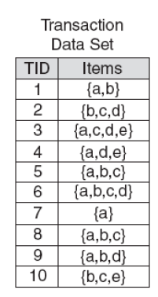
Step 1: FP-Tree Construction
frequency | item
8 | a
7 | b
6 | c
5 | d
3 | e
In our example, assuming min_support = 2 frequent items after sorting in descending order: a, b, c, d, e

Slide 6
Step 1: FP-Tree Construction
Pass 2 – Construct the FP-Tree
Nodes correspond to items and have a counter
FP-Growth reads 1 transaction at a time and maps it to a path
Fixed order is used, so paths can overlap when transactions share items (when they have the same prefix).
In this case, counters are incremented
Pointers are maintained between nodes containing the same item, creating singly linked lists (dotted lines)

Slide 7
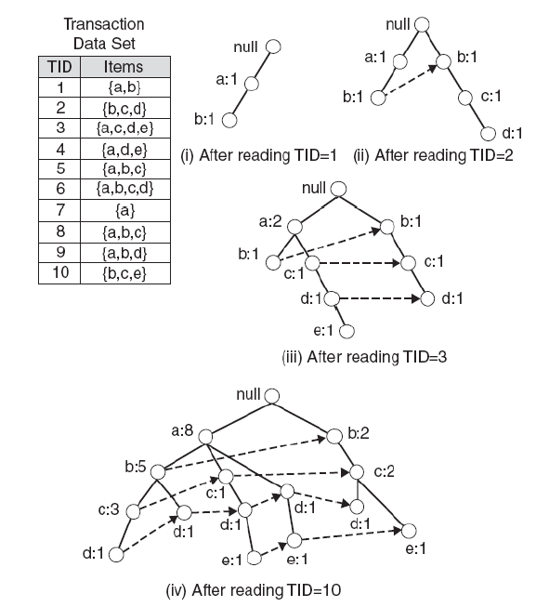
Step 1: FP-Tree Construction (Example)

Slide 8
FP-Tree size
The FP-Tree usually has a smaller size than the uncompressed data - typically many transactions share items (and hence prefixes).
Best case scenario: all transactions contain the same set of items.
1 path in the FP-tree
Worst case scenario: every transaction has a unique set of items (no items in common)
Size of the FP-tree is at least as large as the original data.
Storage requirements for the FP-tree are higher - need to store the pointers between the nodes and the counters.
The size of the FP-tree depends on how the items are ordered
Ordering by decreasing support is typically used but it does not always lead to the smallest tree (it's a heuristic).

Slide 9
Step 2: Frequent Itemset Generation
FP-Growth extracts frequent itemsets from the FP-tree.
Bottom-up algorithm - from the leaves towards the root
Divide and conquer: first look for frequent itemsets ending in e, then de, etc. . . then d, then cd, etc. . .
First, extract prefix path sub-trees ending in an item(set). (hint: use the linked lists)

Slide 10
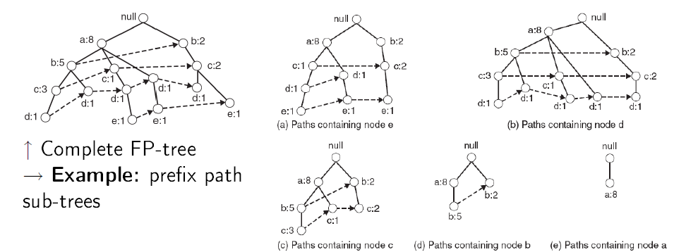
Prefix path sub-trees (Example)

Slide 11
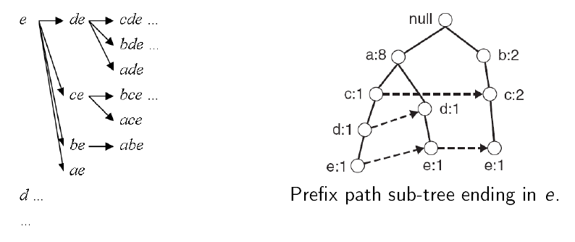
Step 2: Frequent Itemset Generation
Each prefix path sub-tree is processed recursively to extract the frequent itemsets. Solutions are then merged.
E.g. the prefix path sub-tree for e will be used to extract frequent itemsets ending in e, then in de, ce, be and ae, then in cde, bde, ade, etc.
Divide and conquer approach

Slide 12
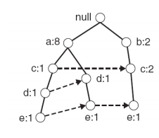
Example
Let minSup = 2 and extract all frequent itemsets containing e.
1. Obtain the prefix path sub-tree for e:

Slide 13
Example
2. Check if e is a frequent item by adding the counts along the linked list (dotted line). If so, extract it.
Yes, count =3 so {e} is extracted as a frequent itemset.
3. As e is frequent, find frequent itemsets ending in e. i.e. de, ce, be and ae.
i.e, decompose the problem recursively
To do this, we must first obtain the conditional FP-tree for e

Slide 14
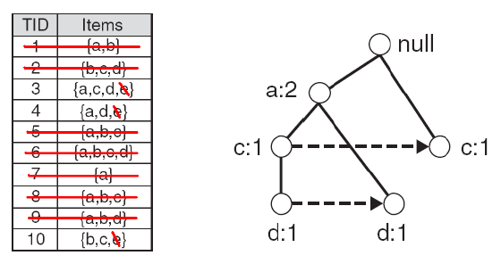
Conditional FP-Tree
The FP-Tree that would be built if we only consider transactions containing a particular itemset (and then removing that itemset from all transactions).
I Example: FP-Tree conditional on e.

Slide 15
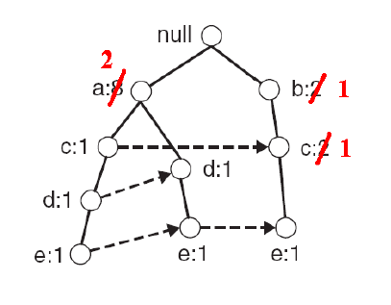
Conditional FP-Tree
To obtain the conditional FP-tree for e from the prefix sub-tree ending in e:
Update the support counts along the prefix paths (from e) to reflect the number of transactions containing e
b and c should be set to 1 and a to 2

Slide 16
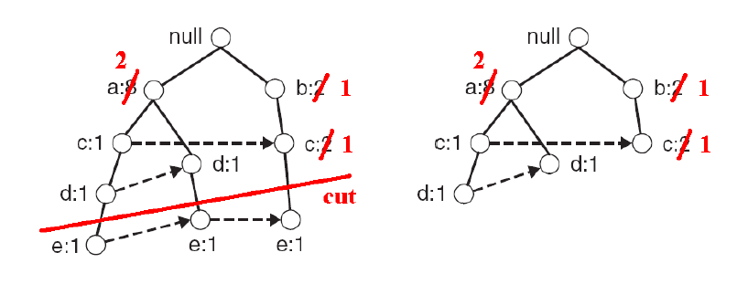
Conditional FP-Tree
To obtain the conditional FP-tree for e from the prefix sub-tree ending in e:
Remove the nodes containing e – information about node e is no longer needed because of the previous step

Slide 17
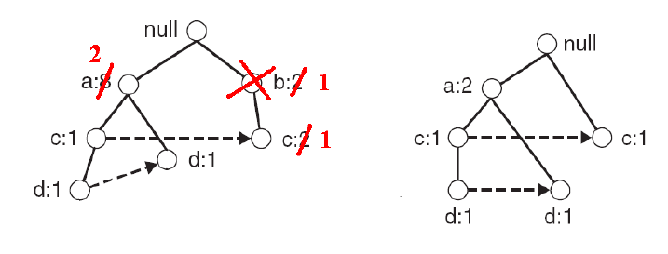
Conditional FP-Tree
To obtain the conditional FP-tree for e from the prefix sub-tree ending in e:
Remove infrequent items (nodes) from the prefix paths
e.g. b has support of 1, i.e. there is only 1 transaction containing b and e, so b can be removed

Slide 18
Example
4. Use the the conditional FP-tree for e to find frequent itemsets ending in de, ce and ae
Note that be is not considered as b is not in the conditional FP-tree for e.
For each of them (e.g. de), find the prefix paths from the conditional tree for e, extract frequent itemsets, generate conditional FP-tree, etc... (recursive)

Slide 19
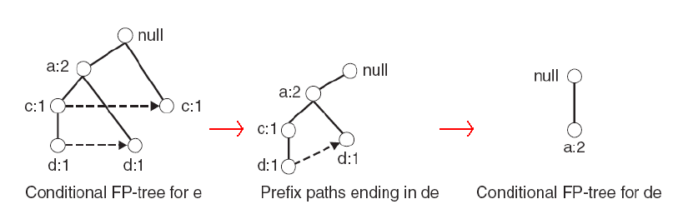
Example
Example: e → de → ade ({d,e}, {a,d,e} are found to be frequent)

Slide 20
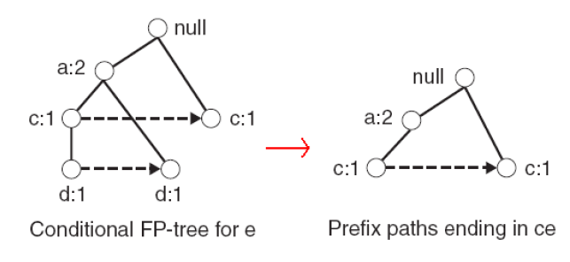
Example
Example: e → ce ({c,e} is found to be frequent)
Etc… (ae, then do the whole thing for d,… etc)

Slide 21
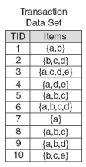
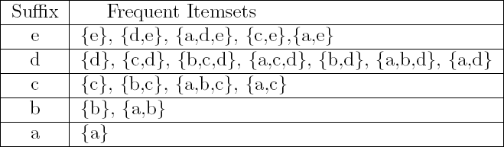
Result
Frequent itemsets found (ordered by sufix and order in which they are found):

Slide 22
Exercise
Given the following database table, find all the frequent itemsets using the FP-Growth algorithm
Assume:
Min_support = 60%
Min_confidence = 80%
Items_bought | TID
{M,O,N,K,E,Y} | T100
{D,O,N,K,E,Y} | T200
{M,A,K,E} | T300
{M,U,C,K,Y} | T400
{C,O,K,I,E} | T500

Slide 23
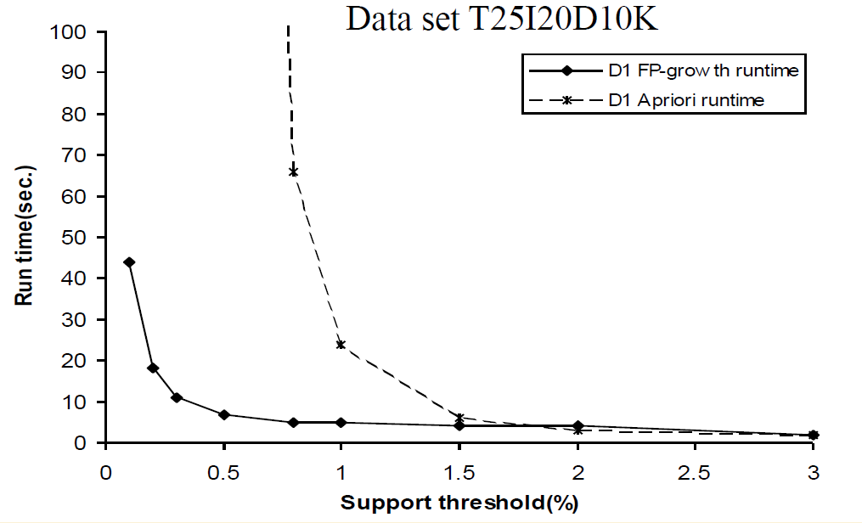
FP-Growth Vs. Apriori
Source: J. Han, J. Pei, and Y. Yin. Mining Frequent Patterns without Candidate Generation. In Proceedings of the 2000 ACM SIGMOD International Conference on Management of Data, Dallas, TX, May 2000.

Slide 24
Why Is FP-Growth the Winner?
Divide-and-conquer:
decompose both the mining task and DB according to the frequent patterns obtained so far
leads to focused search of smaller databases
Other factors
no candidate generation, no candidate test
compressed database: FP-tree structure
no repeated scan of entire database
basic ops—counting local freq items and building sub FP-tree, no pattern search and matching

Slide 25
FP-Growth Disadvantages
Disadvantages of FP-Growth
FP-Tree may not fit in memory!!
FP-Tree is expensive to build
Trade-off: takes time to build, but once it is built, frequent itemsets are read off easily
Time is wasted (especially if support threshold is high), as the only pruning that can be done is on single items

Slide 26
Mining Various Kinds of Association Rules
Mining multilevel association
Miming multidimensional association
Mining quantitative association
Mining interesting correlation patterns

Slide 27
Mining Multiple-Level Association Rules
Items often form hierarchies
Flexible support settings
Items at the lower level are expected to have lower support
uniform support
reduced support
Level 1
min_sup = 5%
Milk
[support = 10%]
Level 1
min_sup = 5%
Level 2
min_sup = 5%
2% Milk
[support = 6%]
Skim Milk
[support = 4%]
Level 2
min_sup = 3%

Slide 28
Multi-level Association: Redundancy Filtering
Some rules may be redundant due to “ancestor” relationships between items.
Example
milk ⇒ wheat bread [support = 8%, confidence = 70%]
2% milk ⇒ wheat bread [support = 2%, confidence = 72%]
We say the first rule is an ancestor of the second rule.
A rule is redundant if its support is close to the “expected” value, based on the rule’s ancestor.

Slide 29
Mining Multi-Dimensional Association
Single-dimensional rules:
buys(X, “milk”) ⇒ buys(X, “bread”)
Multi-dimensional rules: ≥ 2 dimensions or predicates
Inter-dimension assoc. rules (no repeated predicates)
age(X,”19-25”) ∧ occupation(X,“student”) ⇒ buys(X, “coke”)
hybrid-dimension assoc. rules (repeated predicates)
age(X,”19-25”) ∧ buys(X, “popcorn”) ⇒ buys(X, “coke”)
Categorical Attributes: finite number of possible values, no ordering among values—data cube approach
Quantitative Attributes: numeric, implicit ordering among values—discretization, clustering, and gradient approaches

Slide 30
Mining Quantitative Associations
Techniques can be categorized by how numerical attributes, such as age or salary are treated
Static discretization based on predefined concept hierarchies (data cube methods)
Dynamic discretization based on data distribution (quantitative rules, e.g., Agrawal & Srikant@SIGMOD96)
Clustering: Distance-based association (e.g., Yang & Miller@SIGMOD97)
one dimensional clustering then association
Deviation: (such as Aumann and Lindell@KDD99)
Sex = female => Wage: mean=$7/hr (overall mean = $9)

Slide 31
Static Discretization of Quantitative Attributes
Discretized prior to mining using concept hierarchy.
Numeric values are replaced by ranges.
In relational database, finding all frequent k-predicate sets will require k or k+1 table scans.
Data cube is well suited for mining.
The cells of an n-dimensional
cuboid correspond to the
predicate sets.
Mining from data cubes can be much faster.
()
(age)
(income)
(buys)
(age, income)
(age,buys)
(income,buys)
(age,income,buys)

Slide 32
Quantitative Association Rules
Proposed by Lent, Swami and Widom ICDE’97
Numeric attributes are dynamically discretized
Such that the confidence or compactness of the rules mined is maximized
2-D quantitative association rules: A_{quan1} ∧ A_{quan2} ⇒ A_{cat}
Cluster adjacent association rules to form general rules using a 2-D grid
Example
age(X,”34-35”) ∧ income(X,”30-50K”)
⇒ buys(X,”high resolution TV”)

Slide 33
Mining Other Interesting Patterns
Flexible support constraints (Wang et al. @ VLDB’02)
Some items (e.g., diamond) may occur rarely but are valuable
Customized sup_{min} specification and application
Top-K closed frequent patterns (Han, et al. @ ICDM’02)
Hard to specify sup_{min}, but top-k with length_{min} is more desirable
Dynamically raise sup_{min} in FP-tree construction and mining, and select most promising path to mine

Slide 34
Interestingness Measure: Correlations (Lift)
play basketball ⇒ eat cereal [40%, 66.7%] is misleading
The overall % of students eating cereal is 75% > 66.7%.
play basketball ⇒ not eat cereal [20%, 33.3%] is more accurate, although with lower support and confidence
Measure of dependent/correlated events: lift
 | Basketball | Not basketball | Sum (row)
Cereal | 2000 | 1750 | 3750
Not cereal | 1000 | 250 | 1250
Sum(col.) | 3000 | 2000 | 5000

Slide 35
Are lift and χ² Good Measures of Correlation?
“Buy walnuts ⇒ buy milk [1%, 80%]” is misleading
if 85% of customers buy milk
Support and confidence are not good to represent correlations
So many interestingness measures?
 | Milk | No Milk | Sum (row)
Coffee | m, c | ~m, c | c
No Coffee | m, ~c | ~m, ~c | ~c
Sum(col.) | m | ~m | Σ
DB | m, c | ~m, c | m,~c | ~m,~c | lift | all-conf | coh | χ2
A1 | 1000 | 100 | 100 | 10,000 | 9.26 | 0.91 | 0.83 | 9055
A2 | 100 | 1000 | 1000 | 100,000 | 8.44 | 0.09 | 0.05 | 670
A3 | 1000 | 100 | 10000 | 100,000 | 9.18 | 0.09 | 0.09 | 8172
A4 | 1000 | 1000 | 1000 | 1000 | 1 | 0.5 | 0.33 | 0

Slide 36
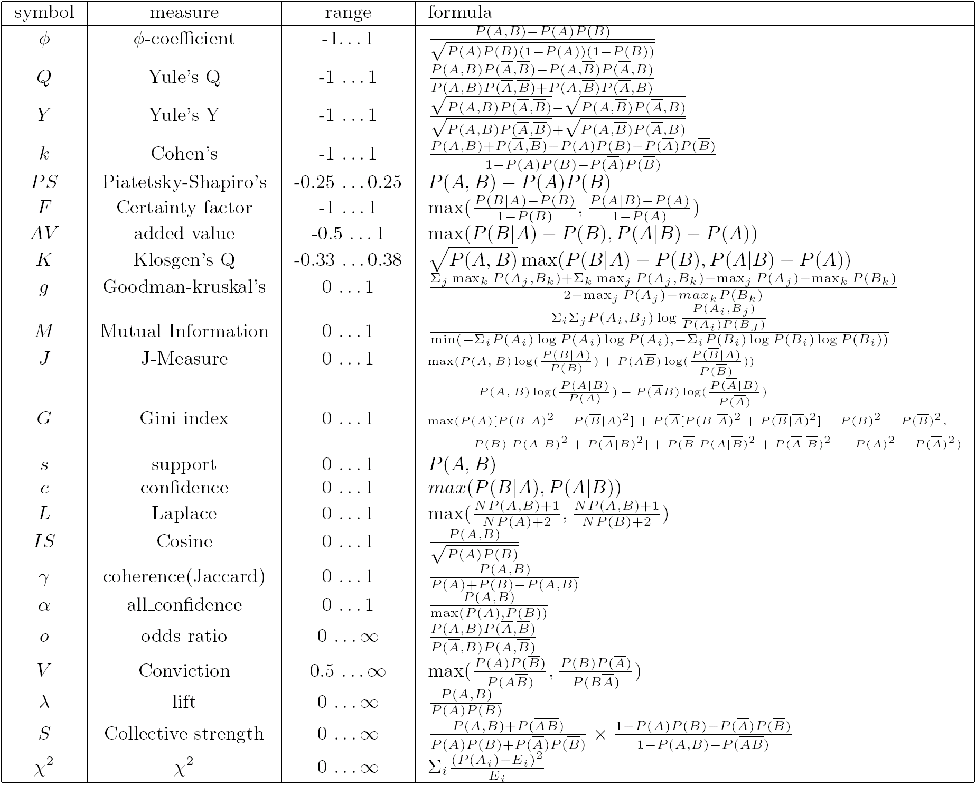
Which Measures Should Be Used?
lift and χ² are not good measures for correlations in large transactional DBs
all-conf or coherence could be good measures)
Both all-conf and coherence have the downward closure property
Efficient algorithms can be derived for mining

Slide 37
Constraint-based (Query-Directed) Mining
Finding all the patterns in a database autonomously? — unrealistic!
The patterns could be too many but not focused!
Data mining should be an interactive process
User directs what to be mined using a data mining query language (or a graphical user interface)
Constraint-based mining
User flexibility: provides constraints on what to be mined
System optimization: explores such constraints for efficient mining—constraint-based mining

Slide 38
Constraints in Data Mining
Knowledge type constraint:
classification, association, etc.
Data constraint — using SQL-like queries
find product pairs sold together in stores in Chicago in Dec.’02
Dimension/level constraint
in relevance to region, price, brand, customer category
Rule (or pattern) constraint
small sales (price < $10) triggers big sales (sum > $200)
Interestingness constraint
strong rules: min_support ≥ 3%, min_confidence ≥ 60%

Slide 39
Anti-Monotonicity in Constraint Pushing
TDB (min_sup=2)
Anti-monotonicity
When an intemset S violates the constraint, so does any of its superset
sum(S.Price) ≤ v is anti-monotone
sum(S.Price) ≥ v is not anti-monotone
Example. C: range(S.profit) ≤ 15 is anti-monotone
Itemset ab violates C
So does every superset of ab
TID | Transaction
10 | a, b, c, d, f
20 | b, c, d, f, g, h
30 | a, c, d, e, f
40 | c, e, f, g
Item | Profit
a | 40
b | 0
c | -20
d | 10
e | -30
f | 30
g | 20
h | -10

Slide 40
Monotonicity for Constraint Pushing
TDB (min_sup=2)
Monotonicity
When an intemset S satisfies the constraint, so does any of its superset
sum(S.Price) ≥ v is monotone
min(S.Price) ≤ v is monotone
Example. C: range(S.profit) ≥ 15
Itemset ab satisfies C
So does every superset of ab
TID | Transaction
10 | a, b, c, d, f
20 | b, c, d, f, g, h
30 | a, c, d, e, f
40 | c, e, f, g
Item | Profit
a | 40
b | 0
c | -20
d | 10
e | -30
f | 30
g | 20
h | -10

Slide 41
Succinctness
Succinctness:
Given A_{1,} the set of items satisfying a succinctness constraint C, then any set S satisfying C is based on A₁ , i.e., S contains a subset belonging to A₁
Idea: Without looking at the transaction database, whether an itemset S satisfies constraint C can be determined based on the selection of items
min(S.Price) ≤ v is succinct
sum(S.Price) ≥ v is not succinct
Optimization: If C is succinct, C is pre-counting pushable

Slide 42
The Apriori Algorithm — Example
Database D
L₁
C₁
Scan D
C₂
C₂
L₂
Scan D
C₃
Scan D
L₃

Slide 43
Naïve Algorithm: Apriori + Constraint
Database D
L₁
C₁
Scan D
C₂
C₂
L₂
Scan D
C₃
Scan D
L₃
Constraint:
Sum{S.price} < 5

Slide 44
The Constrained Apriori Algorithm: Push an Anti-monotone Constraint Deep
Database D
L₁
C₁
Scan D
C₂
C₂
L₂
Scan D
C₃
Scan D
L₃
Constraint:
Sum{S.price} < 5

Slide 45
Converting “Tough” Constraints
TDB (min_sup=2)
Convert tough constraints into anti-monotone or monotone by properly ordering items
Examine C: avg(S.profit) ≥ 25
Order items in value-descending order
<a, f, g, d, b, h, c, e>
If an itemset afb violates C
So does afbh, afb*
It becomes anti-monotone!
TID | Transaction
10 | a, b, c, d, f
20 | b, c, d, f, g, h
30 | a, c, d, e, f
40 | c, e, f, g
Item | Profit
a | 40
b | 0
c | -20
d | 10
e | -30
f | 30
g | 20
h | -10

Slide 46
Strongly Convertible Constraints
avg(X) ≥ 25 is convertible anti-monotone w.r.t. item value descending order R: <a, f, g, d, b, h, c, e>
If an itemset af violates a constraint C, so does every itemset with af as prefix, such as afd
avg(X) ≥ 25 is convertible monotone w.r.t. item value ascending order R⁻¹: <e, c, h, b, d, g, f, a>
If an itemset d satisfies a constraint C, so does itemsets df and dfa, which having d as a prefix
Thus, avg(X) ≥ 25 is strongly convertible
Item | Profit
a | 40
b | 0
c | -20
d | 10
e | -30
f | 30
g | 20
h | -10

Slide 47
Can Apriori Handle Convertible Constraint?
A convertible, not monotone nor anti-monotone nor succinct constraint cannot be pushed deep into the an Apriori mining algorithm
Within the level wise framework, no direct pruning based on the constraint can be made
Itemset df violates constraint C: avg(X)>=25
Since adf satisfies C, Apriori needs df to assemble adf, df cannot be pruned
But it can be pushed into frequent-pattern growth framework!
Item | Value
a | 40
b | 0
c | -20
d | 10
e | -30
f | 30
g | 20
h | -10

Slide 48
Mining With Convertible Constraints
Item | Value
a | 40
f | 30
g | 20
d | 10
b | 0
h | -10
c | -20
e | -30
C: avg(X) >= 25, min_sup=2
List items in every transaction in value descending order R: <a, f, g, d, b, h, c, e>
C is convertible anti-monotone w.r.t. R
Scan TDB once
remove infrequent items
Item h is dropped
Itemsets a and f are good, …
Projection-based mining
Imposing an appropriate order on item projection
Many tough constraints can be converted into (anti)-monotone
TDB (min_sup=2)
TID | Transaction
10 | a, f, d, b, c
20 | f, g, d, b, c
30 | a, f, d, c, e
40 | f, g, h, c, e

Slide 49
What Constraints Are Convertible?
Constraint | Convertible anti-monotone | Convertible monotone | Strongly convertible
avg(S) ≤ , ≥ v | Yes | Yes | Yes
median(S) ≤ , ≥ v | Yes | Yes | Yes
sum(S) ≤ v (items could be of any value, v ≥ 0) | Yes | No | No
sum(S) ≤ v (items could be of any value, v ≤ 0) | No | Yes | No
sum(S) ≥ v (items could be of any value, v ≥ 0) | No | Yes | No
sum(S) ≥ v (items could be of any value, v ≤ 0) | Yes | No | No
……

Slide 50
Constraint-Based Mining—A General Picture
Constraint | Antimonotone | Monotone | Succinct
v ∈ S | no | yes | yes
S ⊇ V | no | yes | yes
S ⊆ V | yes | no | yes
min(S) ≤ v | no | yes | yes
min(S) ≥ v | yes | no | yes
max(S) ≤ v | yes | no | yes
max(S) ≥ v | no | yes | yes
count(S) ≤ v | yes | no | weakly
count(S) ≥ v | no | yes | weakly
sum(S) ≤ v ( a ∈ S, a ≥ 0 ) | yes | no | no
sum(S) ≥ v ( a ∈ S, a ≥ 0 ) | no | yes | no
range(S) ≤ v | yes | no | no
range(S) ≥ v | no | yes | no
avg(S) θ v, θ ∈ { =, ≤, ≥ } | convertible | convertible | no
support(S) ≥ ξ | yes | no | no
support(S) ≤ ξ | no | yes | no

Slide 51
A Classification of Constraints
Monotone
Antimonotone
Strongly
convertible
Succinct
Convertible
anti-monotone
Convertible
monotone
Inconvertible

Slide 52
Frequent-Pattern Mining: Summary
Frequent pattern mining—an important task in data mining
Scalable frequent pattern mining methods
Apriori (Candidate generation & test)
Projection-based (FPgrowth, CLOSET+, ...)
Vertical format approach (CHARM, ...)
Mining a variety of rules and interesting patterns
Lift and other measures
Constraint-based mining

Slide 53
Frequent-Pattern Mining: Research Problems
Mining fault-tolerant frequent, sequential and structured patterns
Mining truly interesting patterns
Surprising, novel, concise, …
Application exploration
E.g., DNA sequence analysis and bio-pattern classification

